Slide 1
Statistics in Sports: What Makes a Good Sports Statistic?
Zachary Binney, PhD MPH
Oxford college of emory university
Fall 2023

Slide 2
Roadmap
What Makes a Good (Sports) Statistic?
Does it match your question?
Does it measure success in the sport? (Validity)
Is it noisy or repeatable/stable? (Reliability)
Is it useful?
Is it better than an alternative?

Slide 3
What Makes a Good (Sports) Statistic?

Slide 4

Does Your Stat Match Your Question?
A statistic starts with a QUESTION
It should be designed to answer that QUESTION
A statistic may be good for one QUESTION but not another
Be transparent and explicit about what your QUESTION is and what the statistic is designed to do – and, critically, not do!
Source: https://twitter.com/bernybelvedere/status/1171435503586926593

Slide 5
Three Types of Questions
1. Descriptive
Describing the world as it is
2. Predictive
Describing the world as it will be
3. Causal (Counterfactual Prediction)
Describing the world as it could be

Slide 6
Does Your Stat Match Your Question?
Player-level stat or team-level stat?
Differences?
In which do you want to isolate the contributions of an individual player?

Slide 7
Does Your Stat Match Your Question?
How good is this running back? – RYOE
How accurate is this quarterback? – CPOE
How good is this quarterback? – EPA per play QB is involved in
How valuable is this quarterback? – Total EPA, WAR

Slide 8
Does Your Stat Match Your Question?
Teams: How much should I pay this player? – WAR, and make sure it has predictive not just descriptive value
Fantasy value of wide receiver? – Target share

Slide 9

Does Your Stat Match Your Question?
Who’s the GOAT? – Need era-adjusted statistic
Some stats aren’t, because they’re meant for another question!!
Source: https://www.tvovermind.com/is-the-new-match-game-doing-justice-to-the-original/

Slide 10
Does It Measure Success in the Sport?
Does the statistic correlate with some gold standard measure of “success?”
Step back: what is the goal/purpose of a sports team? What defines its “success?”

Slide 11
Does It Measure Success in the Sport?
“Success” depends on your question, but common options:
Wins for holistic stats
Points/goals/runs for offensive stats
Points/goals/runs against for defensive stats

Slide 12
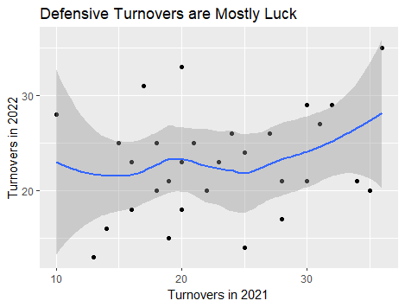
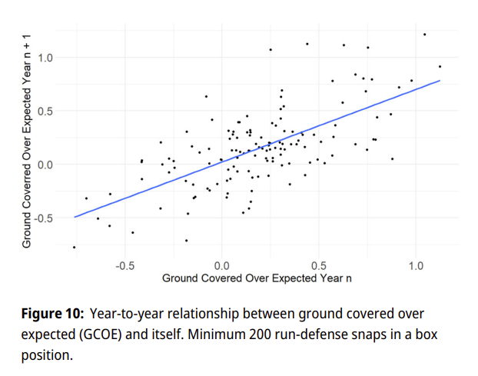
Is The Stat Repeatable/Stable?
Is it measuring signal or noise? “True talent” or luck?
Look at year-to-year (or split half season) correlations
Source: Eager and Seth, JQAS 2023

Slide 13
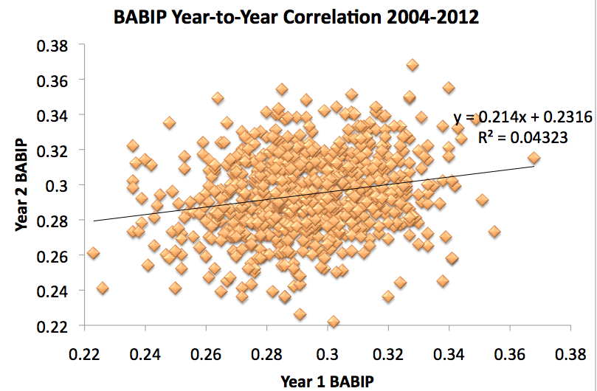
Is The Stat Repeatable/Stable?
Voros McCracken article: batting average on balls in play not repeatable and depend on defense → not a characteristic of a pitcher. Noise.
Remove it to get better idea of “true” pitcher skill – focus only on what they control (walks, strikeouts, home runs, hit batters)
Source: https://www.baseballprospectus.com/news/article/878/pitching-and-defense-how-much-control-do-hurlers-have/, https://www.beyondtheboxscore.com/2013/1/4/3827868/projecting-babip-regression-toward-the-mean-baseball-math-sabermetrics

Slide 14
Is It Useful?
Can you use it to predict or intervene on something?
Predict: Will it help me better predict player performance over the duration of a contract?
Intervene: Does it give me new knowledge about the game I can use to change strategies, player development, etc.?
Not necessary for stat to be good (?), but increases value a lot

Slide 15
Is It Better Than an Alternative?
Does it correlate more with “success in the sport” than the stat you propose it replace?
How does that balance against “complexity” cost?
Cost to gather/analyze data
Cost of complexity/explanation/adoption

Slide 16

Thanks!
Questions? zbinney@emory.edu, @binney_z on Twitter

Slide 17
Appendix – Baseball Stats and Quality Metrics

Slide 18
Batting
DISCLAIMERS: In no way even a comprehensive list of baseball batting player valuation stats
Not using Statcast data (e.g. out-of-zone swing %s)
Many different “flavors” of some stats with different formulas – we use Fangraphs

Slide 19
Batting
Runs (R) and Runs Batted In (RBIs)
Problems/Limitations? (For this and all subsequent slides, don’t look forward until I say so.)
R and RBI

Slide 20
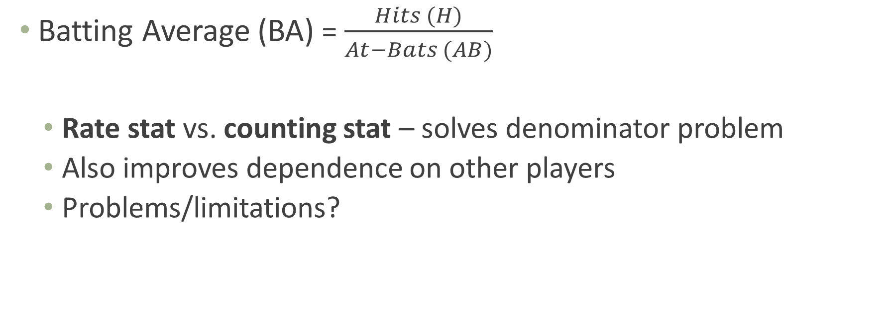
Batting
Batting Average (BA) = $\frac{Hits (H)}{At−Bats (AB)}$
Rate stat vs. counting stat – solves denominator problem
Also improves dependence on other players
Problems/limitations?
R and RBI
BA

Slide 21
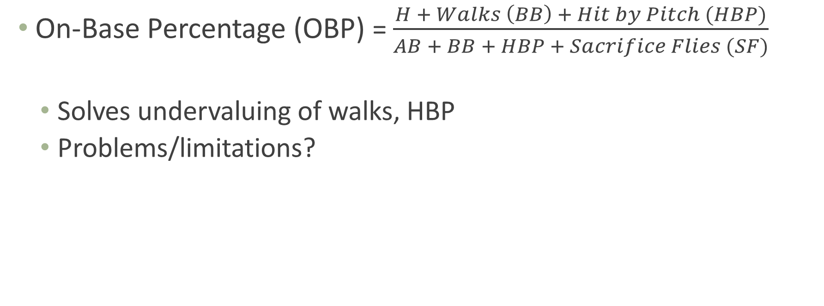
Batting
On-Base Percentage (OBP) = $\frac{H + Walks \left(BB\right) + Hit by Pitch (HBP)}{AB + BB + HBP + Sacrifice Flies (SF)}$
Solves undervaluing of walks, HBP
Problems/limitations?
≈ Plate Appearances (PA)
R and RBI
BA
OBP

Slide 22
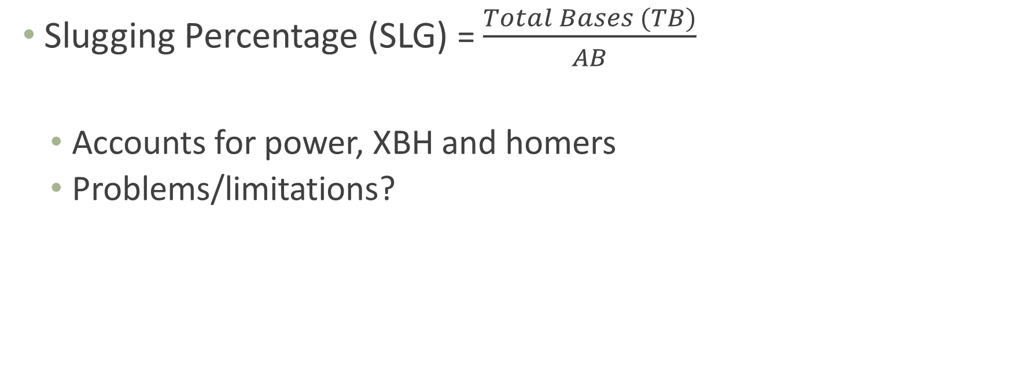
Batting
Slugging Percentage (SLG) = $\frac{Total Bases (TB)}{AB}$
Accounts for power, XBH and homers
Problems/limitations?
R and RBI
BA
SLG
OBP

Slide 23
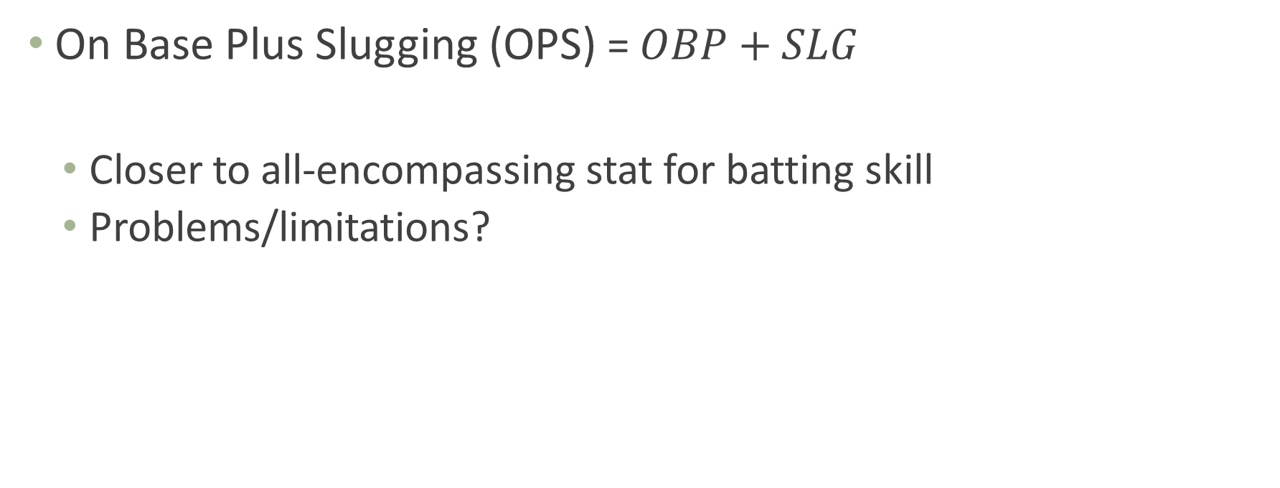
Batting
On Base Plus Slugging (OPS) = $OBP+SLG$
Closer to all-encompassing stat for batting skill
Problems/limitations?
R and RBI
BA
SLG
OBP
OPS

Slide 24
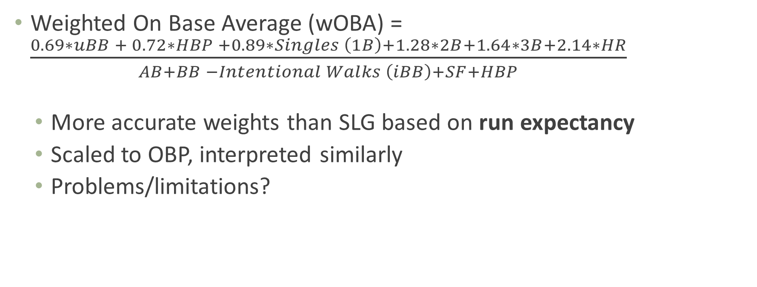
Batting
Weights vary slightly by season based on season OBP
Weighted On Base Average (wOBA) = $\frac{0.69∗uBB + 0.72∗HBP +0.89∗Singles \left(1B\right)+1.28∗2B+1.64∗3B+2.14∗HR}{AB+BB −Intentional Walks \left(iBB\right)+SF+HBP}$
More accurate weights than SLG based on run expectancy
Scaled to OBP, interpreted similarly
Problems/limitations?
R and RBI
BA
SLG
OBP
wOBA
OPS

Slide 25
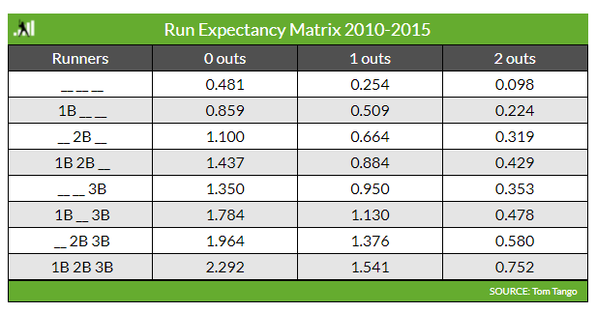
Run Expectancy
Run Expectancy (RE): every PA moves you from one state to another
Ex.: leadoff single goes from 0.481 to 0.859 → worth 0.378 expected runs
Average over all singles → RE for singles, which is (part of) the singles weight for wOBA
Source: https://library.fangraphs.com/the-beginners-guide-to-deriving-woba/

Slide 26
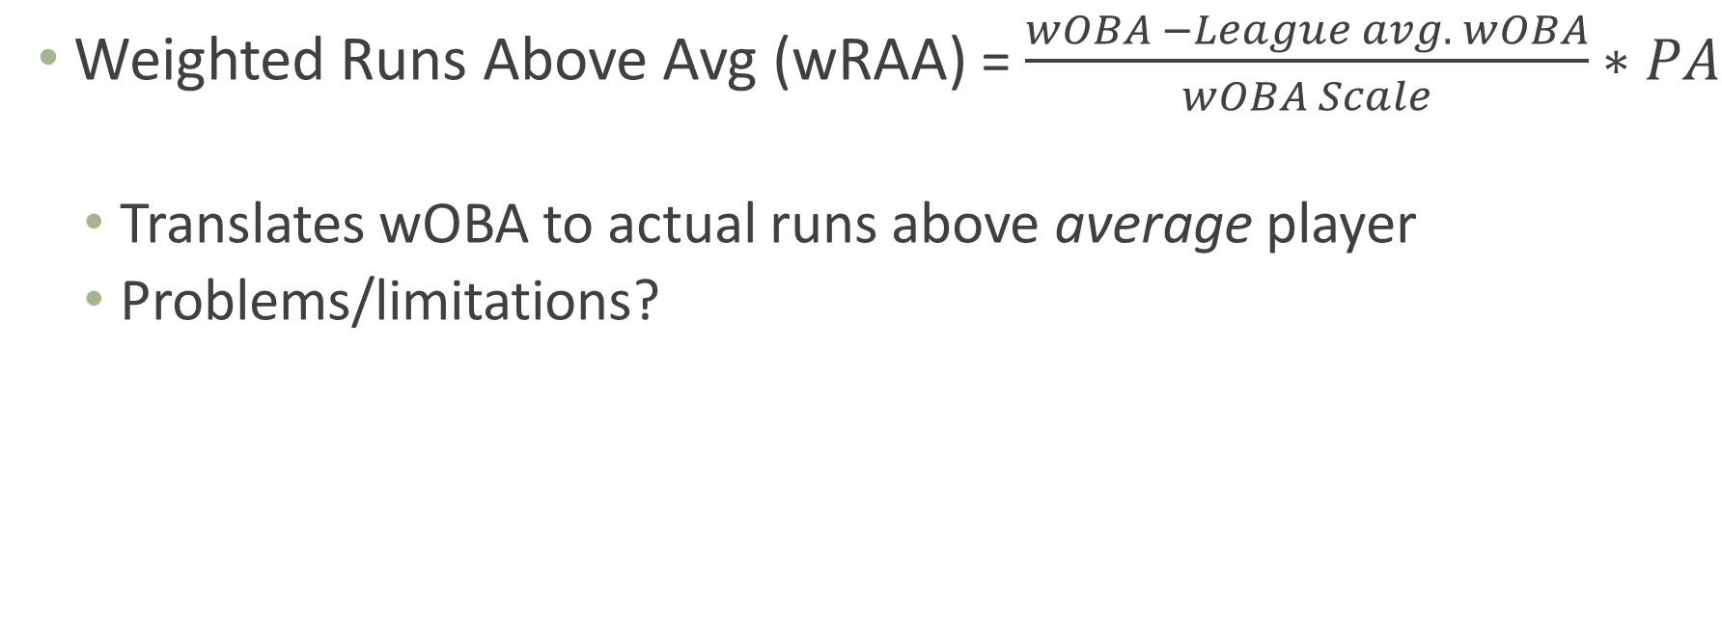
Batting
Weighted Runs Above Avg (wRAA) = $\frac{wOBA −League avg. wOBA}{wOBA Scale}∗PA$
Translates wOBA to actual runs above average player
Problems/limitations?
Undoes scaling so wOBA represents actual expected runs
R and RBI
BA
SLG
OBP
wRAA
wOBA
OPS

Slide 27
Batting
(Batting) Wins Above Replacement (WAR) = Complicated
Adjusts for park, league, position; compares to replacement player
Then translates runs to wins (1 win ≈ 9-10 runs)
Ultimate value. How much $ is a win worth x (total) WAR = contract value
R and RBI
BA
SLG
OBP
wRAA
wOBA
WAR
OPS

Slide 28
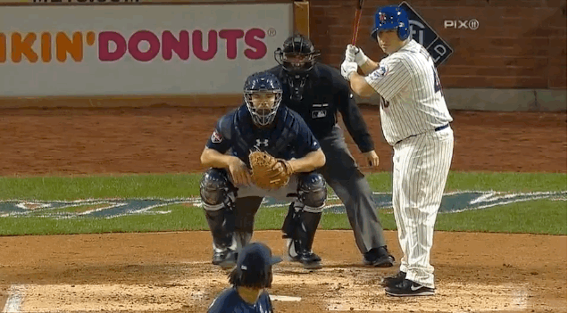
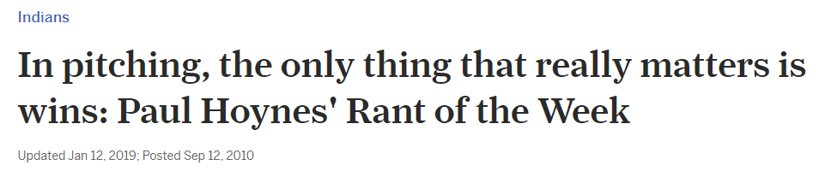
Pitching
Wins (or Win-Loss Record, W-L)
Problems/limitations?
W-L
Source: https://www.cleveland.com/tribe/2010/09/in_pitching_all_that_matters_a.html; https://nesn.com/2014/04/mets-pitcher-bartolo-colon-swings-hard-misses-pitch-loses-helmet-gif/

Slide 29
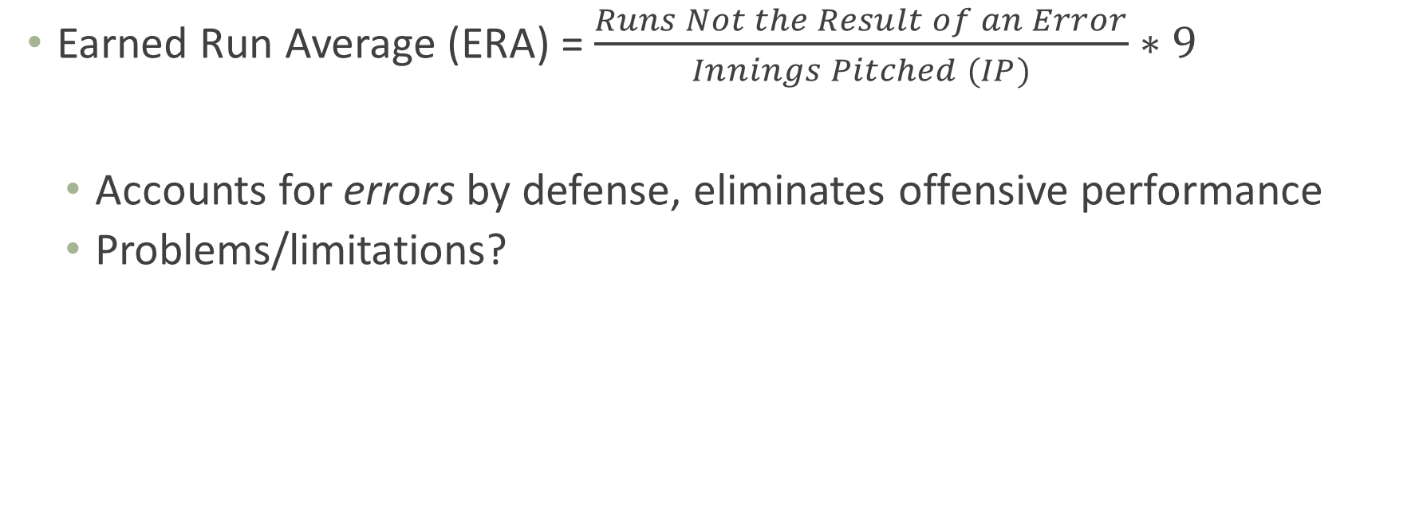
Pitching
Earned Run Average (ERA) = $\frac{Runs Not the Result of an Error}{Innings Pitched (IP)}∗9$
Accounts for errors by defense, eliminates offensive performance
Problems/limitations?
W-L
ERA

Slide 30
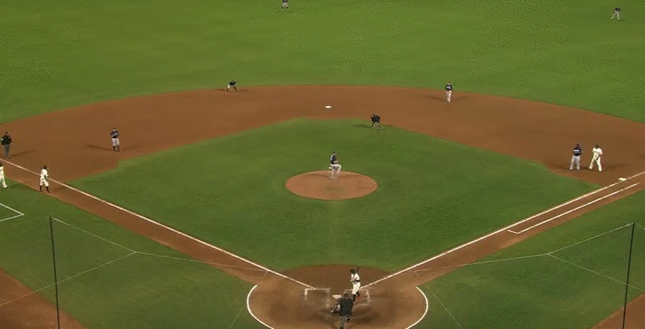
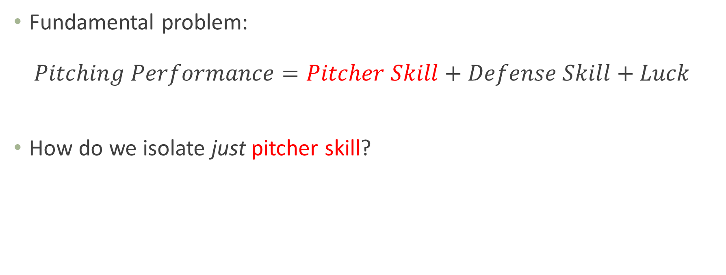
Breaking Down Pitching Performance
Fundamental problem: $Pitching Performance=Pitcher Skill+Defense Skill+Luck$
How do we isolate just pitcher skill?
Enter Defense-Independent Pitching Statistics (DIPS) – despite name, try to deal with defensive skill and luck
Source: https://i.gifer.com/OOxX.gif

Slide 31
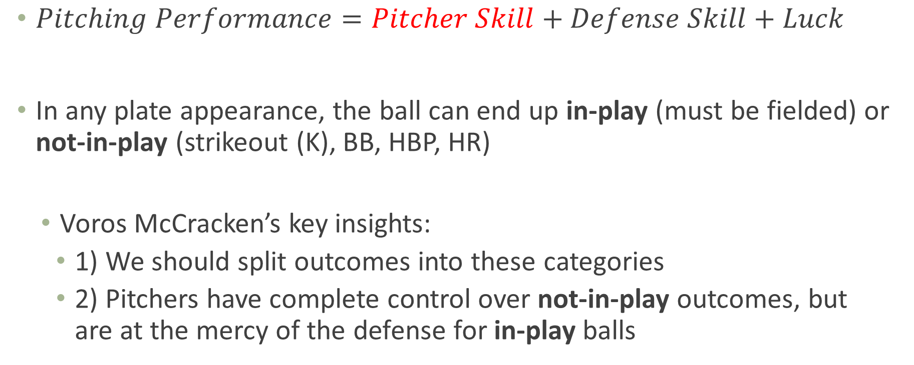
Breaking Down Pitching Performance
$Pitching Performance=Pitcher Skill+Defense Skill+Luck$
In any plate appearance, the ball can end up in-play (must be fielded) or not-in-play (strikeout (K), BB, HBP, HR)
Voros McCracken’s key insights:
1) We should split outcomes into these categories
2) Pitchers have complete control over not-in-play outcomes, but are at the mercy of the defense for in-play balls

Slide 32
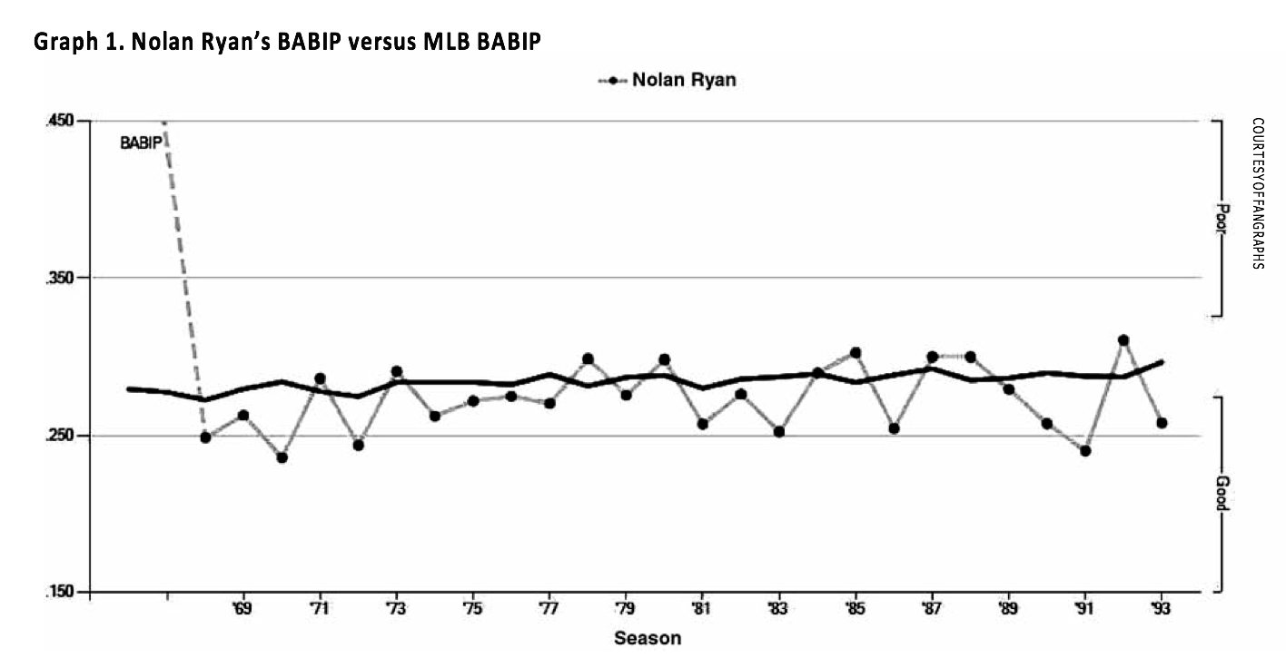
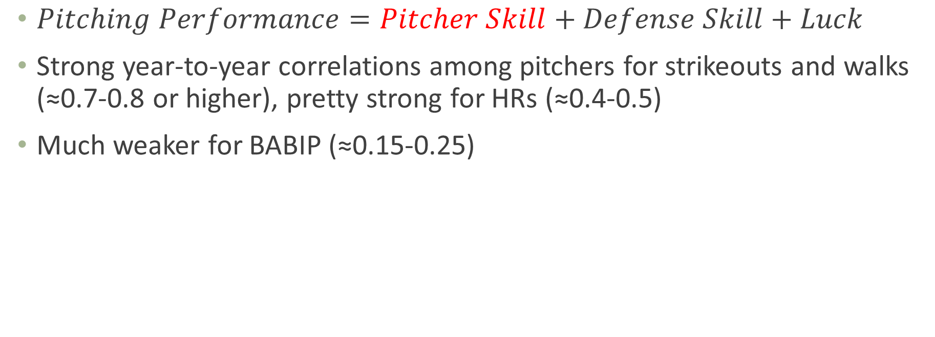
Batting Average on Balls in Play (BABIP)
$Pitching Performance=Pitcher Skill+Defense Skill+Luck$
Strong year-to-year correlations among pitchers for strikeouts and walks (≈0.7-0.8 or higher), pretty strong for HRs (≈0.4-0.5)
Much weaker for BABIP (≈0.15-0.25)
Source: http://sabr.org/journal/article/the-many-flavors-of-dips-a-history-and-an-overview/

Slide 33
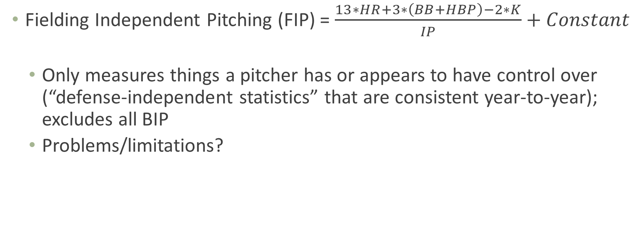
Pitching
To make FIP read like ERA
Fielding Independent Pitching (FIP) = $\frac{13∗HR+3∗\left(BB+HBP\right)−2∗K}{IP}+Constant$
Only measures things a pitcher has or appears to have control over (“defense-independent statistics” that are consistent year-to-year); excludes all BIP
Problems/limitations?
W-L
ERA
DIPS (FIP)

Slide 34

Ground and Fly Balls
Of course it’s not really that simple
Pitchers don’t control overall BABIP, but do control:
% ground balls (GB)
% fly balls (FB)
Ratio GB/FB
Etc.
Stats like tRA, QERA, SIERA take this batted ball data into account
In-season vs. next season projections
Source: https://medium.com/@mxoliverleigh/really-it-should-not-be-this-complicated-fd8a13056747

Slide 35
Pitching
(Pitching) WAR = Complicated, again
Adds infield flies to FIP, translates to runs, adjusts for park and league, then translates to wins (but here every pitcher has a different runs per win metric), compares to replacement level
Remember this is Fangraphs WAR; other sources may use something other than FIP as basis
Ultimate value. How much $ is a win worth x (total) WAR = contract value
W-L
ERA
WAR
DIPS (FIP)

Slide 36
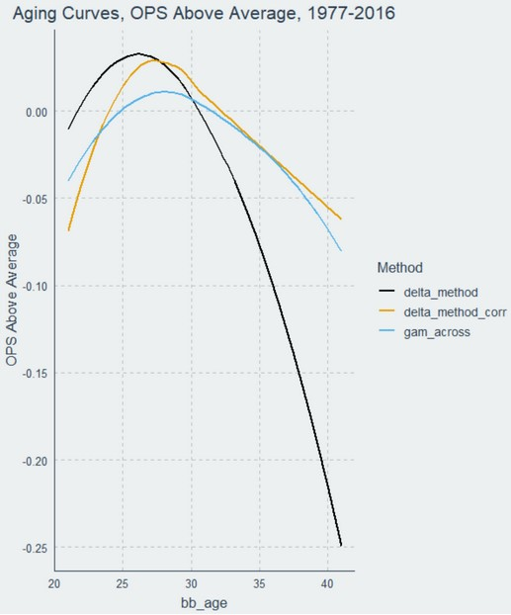
Predicting Future Value
Different from cross-sectional stats describing what an athlete is, we need to know what an athlete will be
Two challenges: 1) Try to identify a player’s true talent, and then 2) project that forward
Repeatability: look for stats that are either stable year-to-year, or at least predictive of future performance
Not luck-based
Adjust for things you know will happen (e.g. aging curves)
Source: https://www.baseballprospectus.com/news/article/59972/the-delta-method-revisited/, https://arxiv.org/abs/1802.00998

Slide 37
The Scientific Process
Is there a better alternative to measure what you’re trying to measure?
Science is built on accumulating small answers that lead to big insights – “get a little less wrong each day”
No single analysis answers everything – understand and accept that
BUT sometimes an analysis is worse than no analysis at all; judgement call

